Slide 1
MCQ QUIZ SYSTEM
Submitted to:- submitted by:-
Himanshu sir 1. harsh
2. dipanshu sajwan
3. Abhishek jakhmola

Slide 2
inTRODUCTION
It is an online quiz system where we can organize an exam in Multiple Choice Mode.
You can enter the website in two modes: 1. User 2. Admin
The Admin has the authority to setup the questions.
User will enter the exam and submit their answers.
Based on that they will get their scores.

Slide 3
Modules
Signup
Admin Login
User Login
Insert Questions
Remove Questions
Score Evaluation

Slide 4
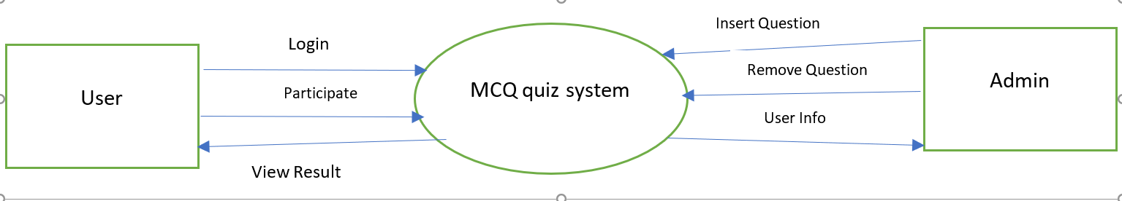
DFD LEVEL 0

Slide 5
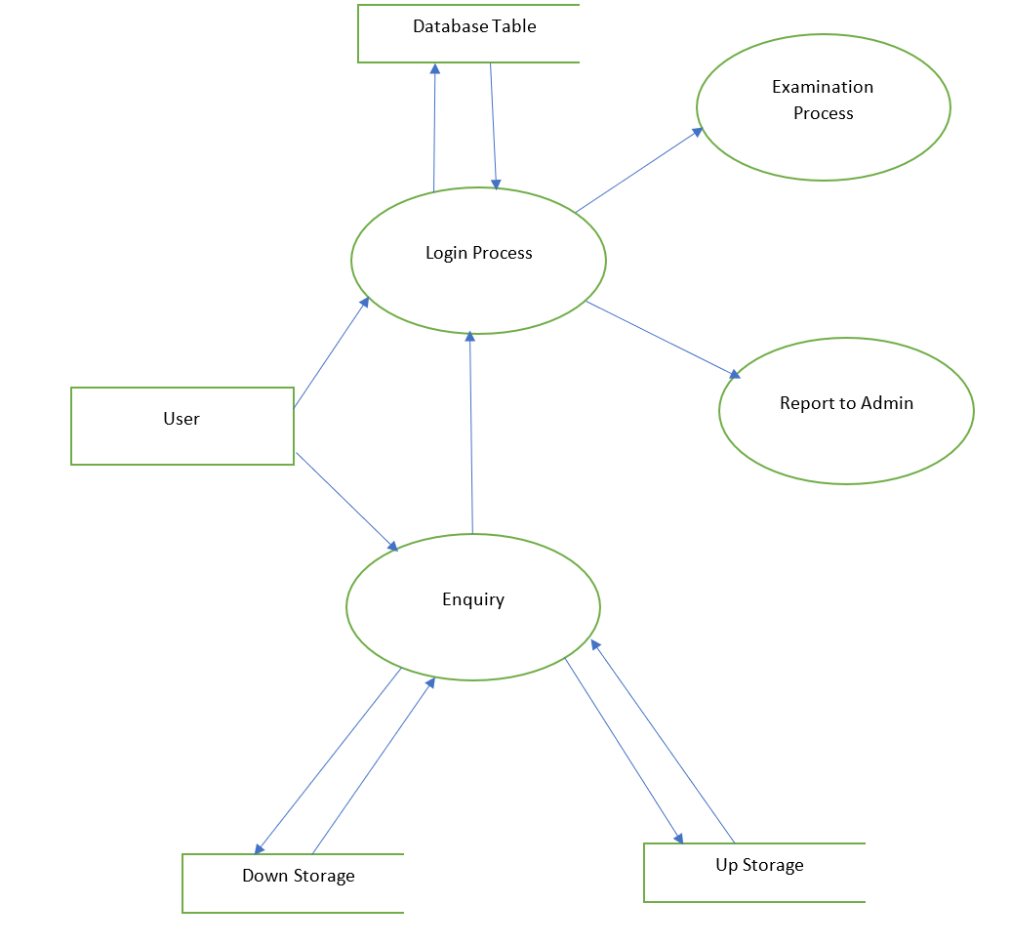
DFD LEVEL 1

Slide 6
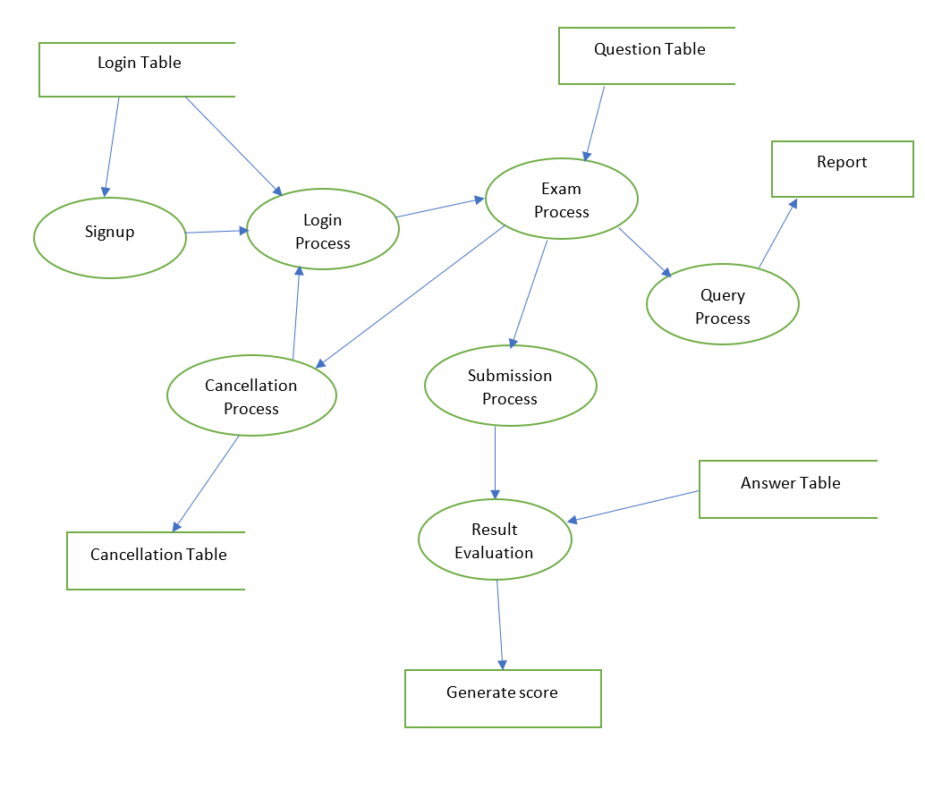
DFD LEVEL 2

Slide 7

HOME PAGE

Slide 8
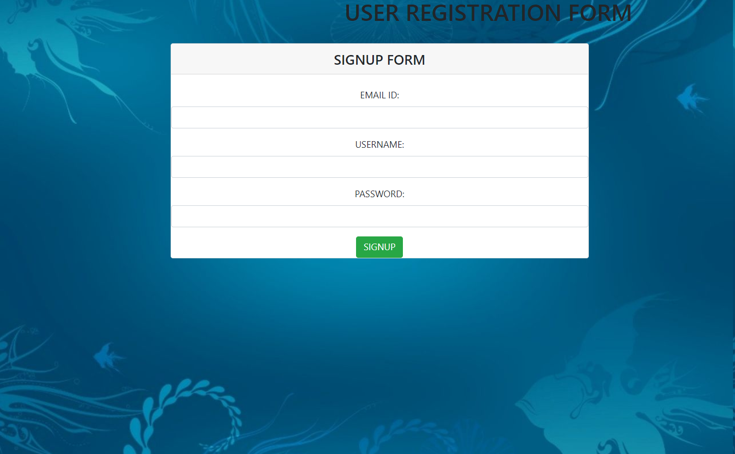
SIGNUP PAGE

Slide 9
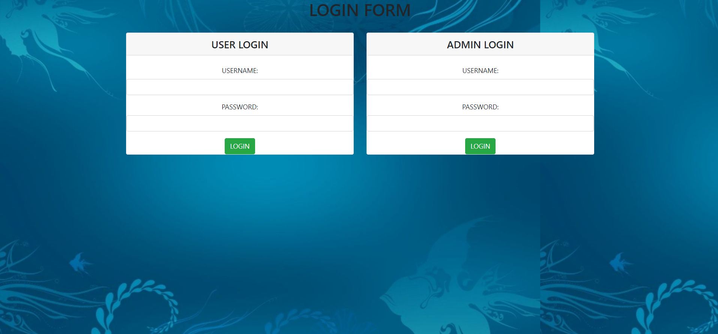
LOGIN PAGE

Slide 10
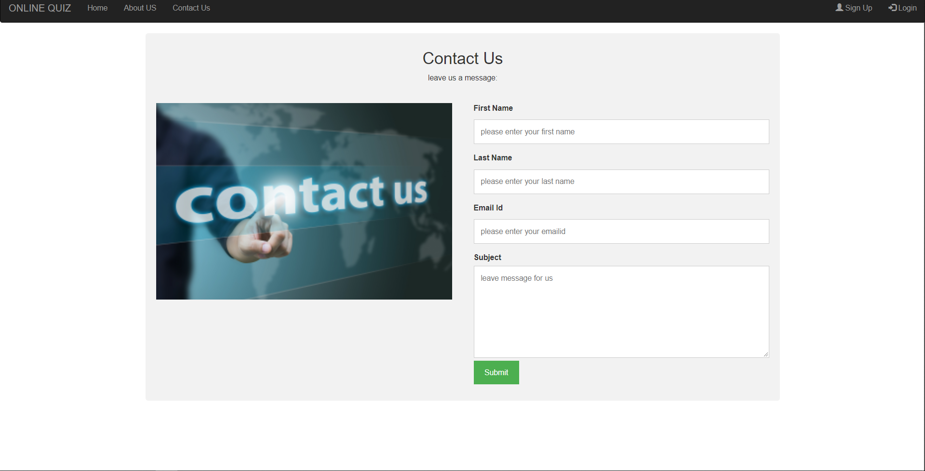
ABOUT US

Slide 11
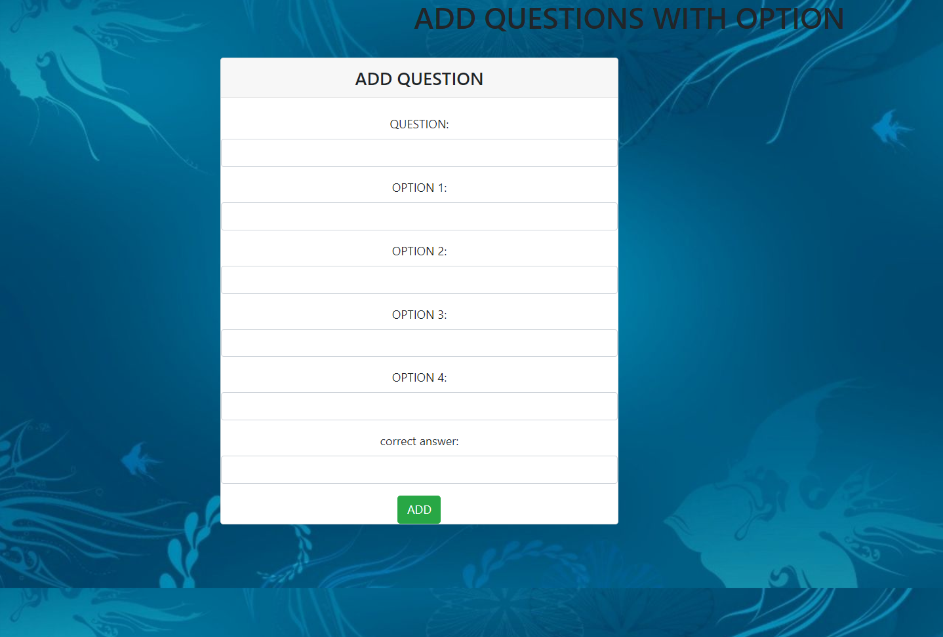
ADD QUESTION

Slide 12
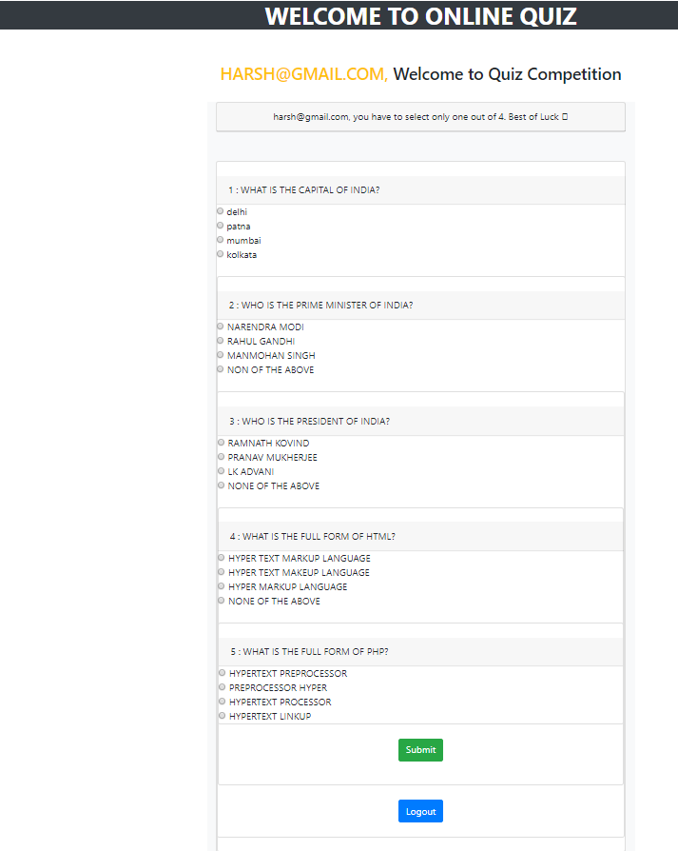
MCQ page

Slide 13
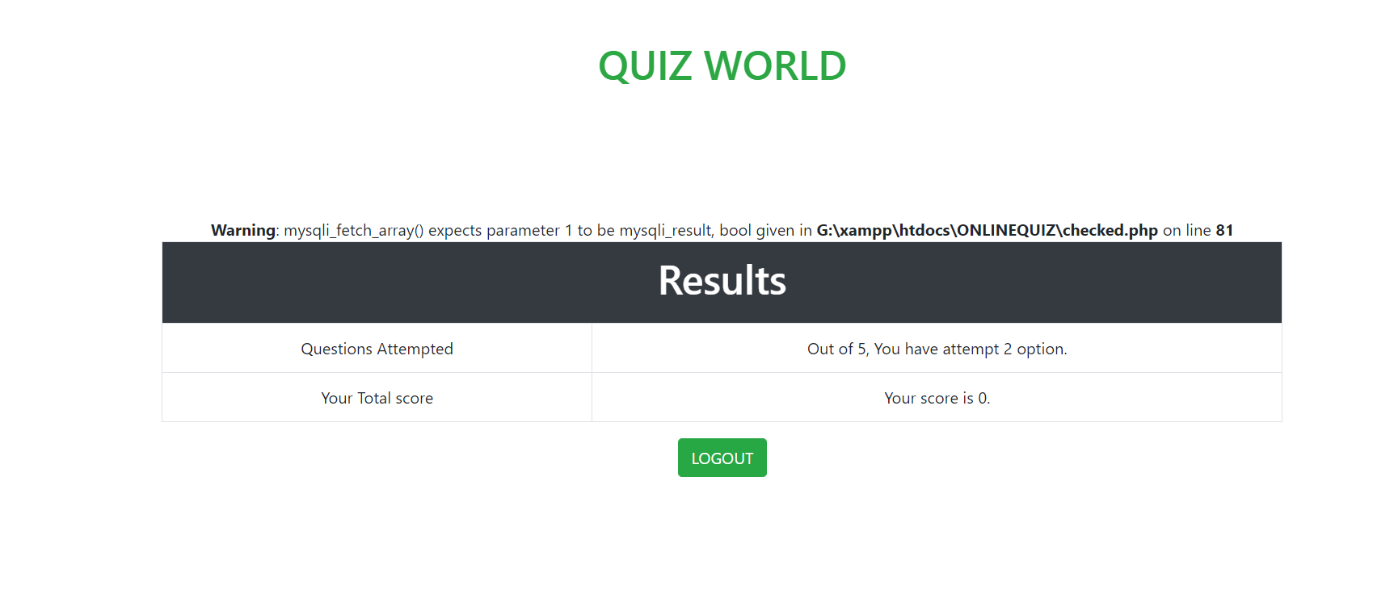
Result show

Slide 14
Requirements
PHP(Hypertext Preprocessor)
Windows OS
XAMP
MySQL

Slide 15
THANKYOU

